Slide 1
Feed
Adrian Kwong, Ahmed AlMadan, OmarAlShangiti, Xiaoyu Qu,
Qiaosi Wang

Slide 2
Problem Statement
Zero Hunger
One in eight Americans face hunger
795 million people out of 7.3 billion in the world were starving in 2014-2016
Food banks don’t have specific food such as dairy and protein products
Super markets still waste food.
13.3 billion tons of food are wasted by supermarkets yearly (BusinessInsider)
We are trying to increase food resources to food banks by matching supermarkets to food banks
Notes:
*Emphasize that we want the wasted food from supermarkets, not normal sale goods
*43 billion pounds of food purchased from stores was thrown away(10% of food purchased) –CNBC

Slide 3
Concept
Connect supermarkets to food banks
Users: Food bank, supermarkets and drivers
Function: Supermarkets input what they are going to donate
Food bank inputs what they need the most
Drivers get notified when to pick up and where to drop off items
Transportation: Volunteers will go to supermarkets, pick up donation items, and drop them off at food banks depending on what they need
Introduce app to food banks who will act as influencers to the supermarkets
Notes:
We are unique because we let food banks identify what they need the most (dairy/proteins)

Slide 4
Sustainability
We will rely on donations from individuals and CSR companies to fund our operations
Companies like Walmart, Target, Starbucks, and Albertsons support the Feeding America organization
We help companies save money by taking care of food disposal
Notes:
CSR = corporate social repsonsibility
$144 per ton for disposal in King County

Slide 5
Expandability
Recommend the app to supermarkets and food banks
Doesn’t take many resources to expand
Give supermarkets and food banks the app
Hire/get more volunteers
Volunteers can get benefits for delivering food such as a share of the food they transport
Some sponsor benefits (such as gift cards)

Slide 6
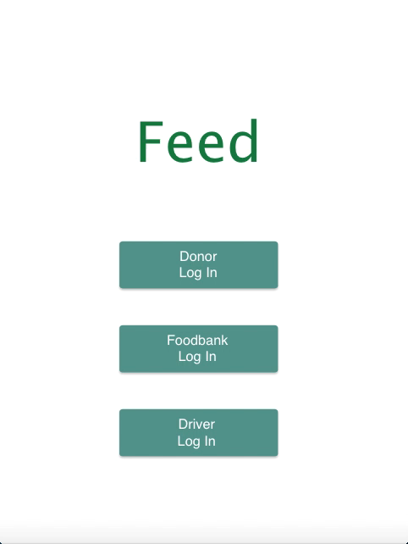

Prototype
Donor Login
Deliver by driver
Deliver myself

Slide 7

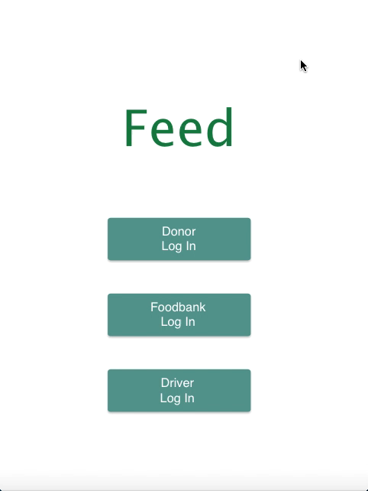
Prototype
1.Driver Login
2. Food Bank Login

Slide 8
References
WorldHunger.org - http://www.worldhunger.org/2015-world-hunger-and-poverty-facts-and-statistics/
Business Insider - http://www.businessinsider.com/why-grocery-stores-throw-out-so-much-food-2014-10
http://www.fao.org/save-food/resources/keyfindings/en/
Feeding America - http://www.feedingamerica.org/about-us/about-feeding-america/partners/food-and-fund-partners/
Rainier Valley Food Bank
North Helpline

